Slide 1
CSE 417T Introduction to Machine Learning
Lecture 7 Instructor: Chien-Ju (CJ) Ho

Slide 2
Logistics
HW1: Due Sep 23
Reserve time if you have never used Gradescope
Check that submission is readable (if you scan your handwriting)
Correctly assign pages to each problem (you won’t get points otherwise)
HW2: Will be announce later this week
Exam dates
Exam 1: October 27
We expect to finish the content for exam1 several lectures before the exam.
Exam 2: December 8

Slide 3
Recap

Slide 4
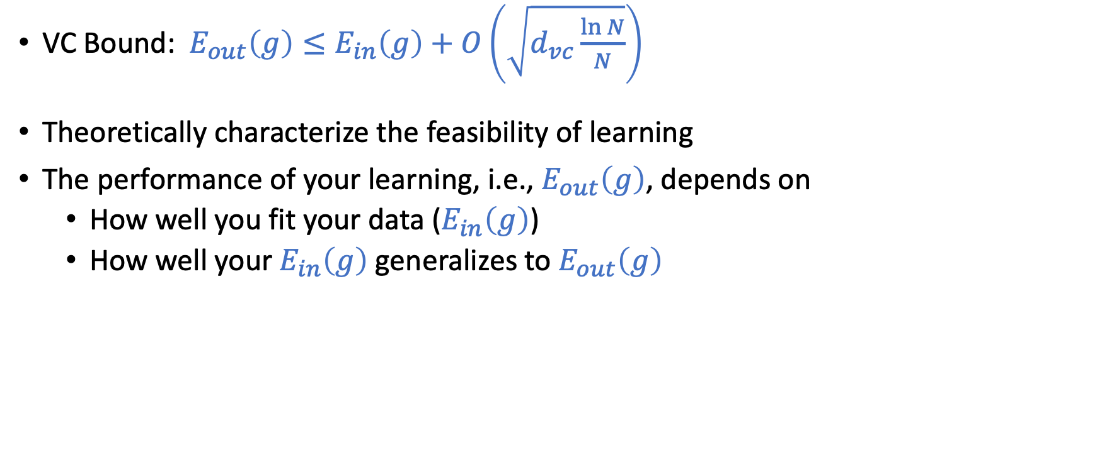
VC Generalization Bound
VC Bound: $E_{out}\left(g\right)≤E_{in}\left(g\right)+O\left(\sqrt{d_{vc}\frac{\ln{N}}{N}}\right)$
Theoretically characterize the feasibility of learning
The performance of your learning, i.e., $E_{out}\left(g\right)$, depends on
How well you fit your data ($E_{in}\left(g\right)$)
How well your $E_{in}\left(g\right)$ generalizes to $E_{out}\left(g\right)$

Slide 5
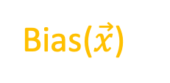
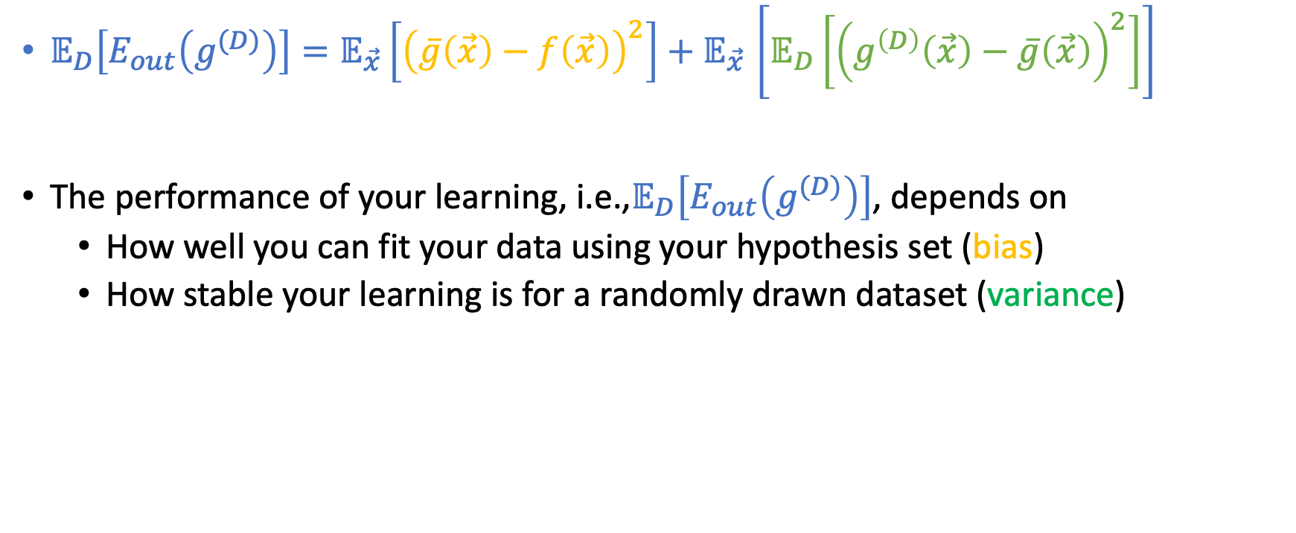
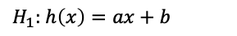
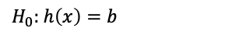
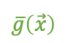
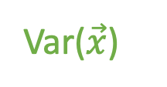
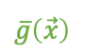
Bias-Variance Decomposition
Bias($\vec{x}$)
Var($\vec{x}$)
$𝔼_{D}\left[E_{out}\left(g^{(D)}\right)\right]{=𝔼_{\vec{x}}\left[{\left(\overline{g}\left(\vec{x}\right)−f\left(\vec{x}\right)\right)}^{2}\right]+𝔼}_{\vec{x}}\left[𝔼_{D}\left[{\left(g^{\left(D\right)}\left(\vec{x}\right)−\overline{g}\left(\vec{x}\right)\right)}^{2}\right]\right]$
The performance of your learning, i.e.,$𝔼_{D}\left[E_{out}\left(g^{(D)}\right)\right]$, depends on
How well you can fit your data using your hypothesis set (bias)
How stable your learning is for a randomly drawn dataset (variance)
$H_{0}:$ $h\left(x\right)=b$
$H_{1}:$ $h\left(x\right)=ax+b$
$$\overline{g}\left(\vec{x}\right)$$
$$\overline{g}\left(\vec{x}\right)$$

Slide 6
Today’s Lecture
The notes are not intended to be comprehensive. They should be accompanied by lectures and/or textbook.
Let me know if you spot errors.

Slide 7
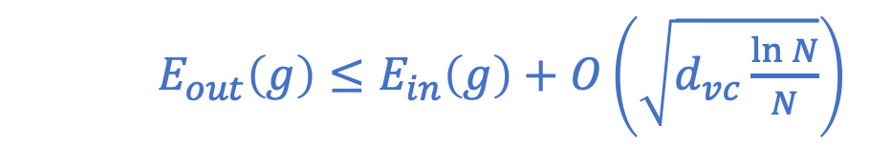
Two Theories of Generalization
VC Generalization Bound
Bias-Variance Tradeoff
$E_{out}\left(g\right)≤E_{in}\left(g\right)+O\left(\sqrt{d_{vc}\frac{\ln{N}}{N}}\right)$
$$𝔼_{D}\left[E_{out}\left(g^{(D)}\right)\right]{=𝔼_{\vec{x}}\left[{\left(\overline{g}\left(\vec{x}\right)−f\left(\vec{x}\right)\right)}^{2}\right]+𝔼}_{\vec{x}}\left[𝔼_{D}\left[{\left(g^{\left(D\right)}\left(\vec{x}\right)−\overline{g}\left(\vec{x}\right)\right)}^{2}\right]\right]$$

Slide 8
Learning Curves

Slide 9
Learning Curves

Slide 10
Learning Curves

Slide 11
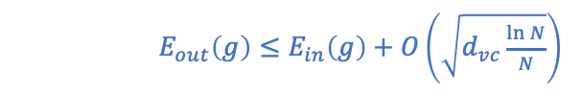

Learning Curves
$$𝔼_{D}\left[E_{out}\left(g^{(D)}\right)\right] \\ {=𝔼_{\vec{x}}\left[{\left(\overline{g}\left(\vec{x}\right)−f\left(\vec{x}\right)\right)}^{2}\right]+𝔼}_{\vec{x}}\left[𝔼_{D}\left[{\left(g^{\left(D\right)}\left(\vec{x}\right)−\overline{g}\left(\vec{x}\right)\right)}^{2}\right]\right]$$
$E_{out}\left(g\right)≤E_{in}\left(g\right)+O\left(\sqrt{d_{vc}\frac{\ln{N}}{N}}\right)$

Slide 12
Learning Curves
$$𝔼_{D}\left[E_{out}\left(g^{(D)}\right)\right] \\ {=𝔼_{\vec{x}}\left[{\left(\overline{g}\left(\vec{x}\right)−f\left(\vec{x}\right)\right)}^{2}\right]+𝔼}_{\vec{x}}\left[𝔼_{D}\left[{\left(g^{\left(D\right)}\left(\vec{x}\right)−\overline{g}\left(\vec{x}\right)\right)}^{2}\right]\right]$$
$E_{out}\left(g\right)≤E_{in}\left(g\right)+O\left(\sqrt{d_{vc}\frac{\ln{N}}{N}}\right)$

Slide 13
Learning Curves
$$𝔼_{D}\left[E_{out}\left(g^{(D)}\right)\right] \\ {=𝔼_{\vec{x}}\left[{\left(\overline{g}\left(\vec{x}\right)−f\left(\vec{x}\right)\right)}^{2}\right]+𝔼}_{\vec{x}}\left[𝔼_{D}\left[{\left(g^{\left(D\right)}\left(\vec{x}\right)−\overline{g}\left(\vec{x}\right)\right)}^{2}\right]\right]$$
$E_{out}\left(g\right)≤E_{in}\left(g\right)+O\left(\sqrt{d_{vc}\frac{\ln{N}}{N}}\right)$

Slide 14
Our focus so far

Slide 15
Let’s spend some time here

Slide 16
Linear Models

Slide 17
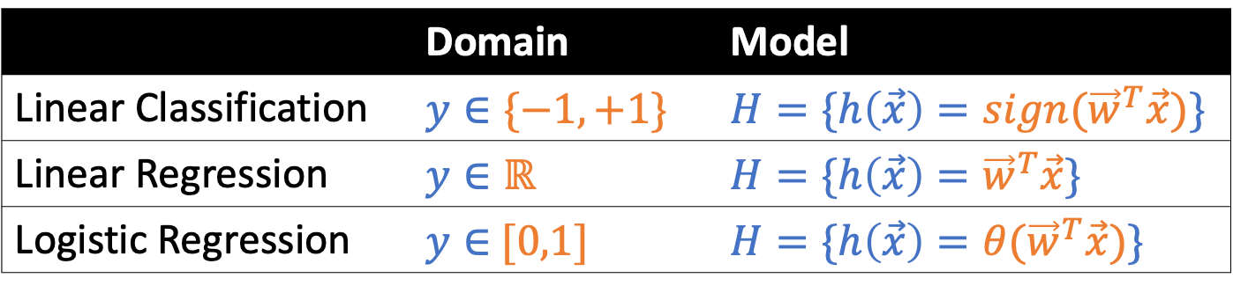
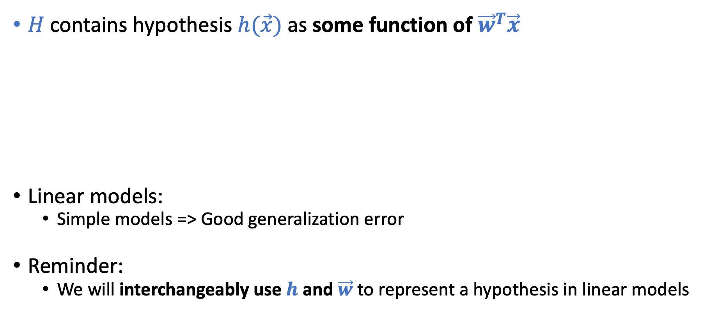
Linear Models
This is why it’s called linear models
$H$ contains hypothesis $h(\vec{x})$ as some function of ${\vec{w}}^{T}\vec{x}$
Linear models:
Simple models => Good generalization error
Reminder:
We will interchangeably use $h$ and $\vec{w}$ to represent a hypothesis in linear models
 | Domain | Model
Linear Classification | $$y∈\{−1,+1\}$$ | $$H=\{h\left(\vec{x}\right)={sign(\vec{w}}^{T}\vec{x})\}$$
Linear Regression | $$y∈ℝ$$ | $$H=\{h\left(\vec{x}\right)={\vec{w}}^{T}\vec{x}\}$$
Logistic Regression | $y∈$ $[0,1]$ | $$H=\{h\left(\vec{x}\right)={θ(\vec{w}}^{T}\vec{x})\}$$
Credit Card Example
Approve or not
Credit line
Prob. of default
$$θ\left(s\right)=\frac{e^{s}}{1+e^{s}}$$

Slide 18
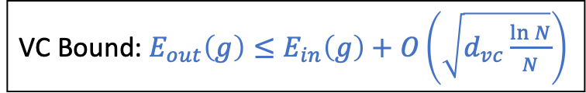
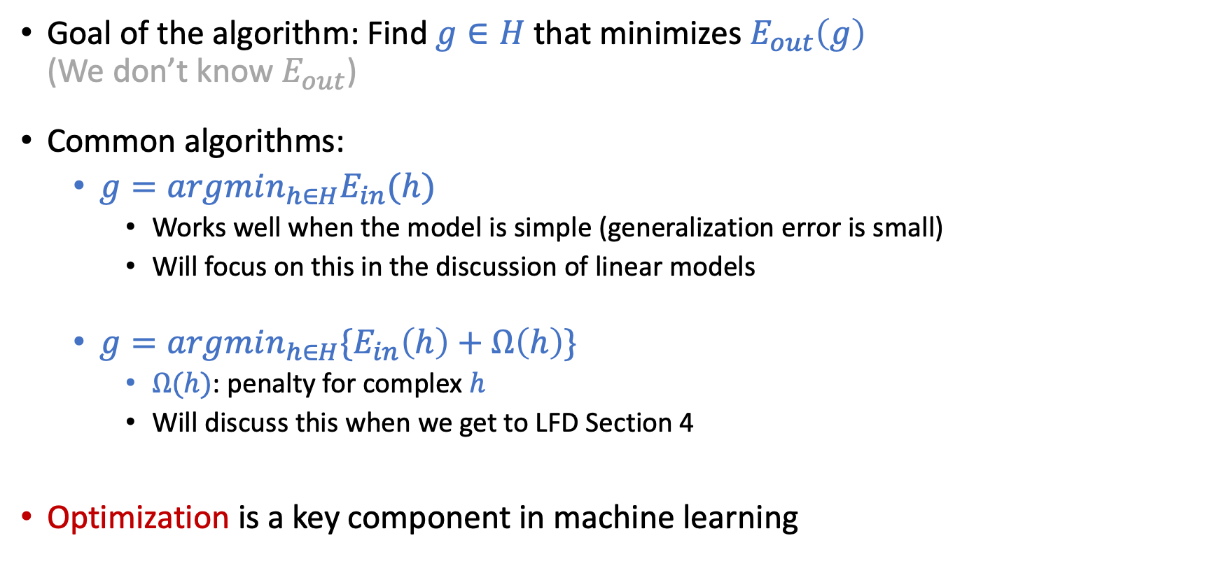
Learning Algorithm?
Goal of the algorithm: Find $g∈H$ that minimizes $E_{out}\left(g\right)$ (We don’t know $E_{out}$)
Common algorithms:
$g=argmin_{h∈H}E_{in}(h)$
Works well when the model is simple (generalization error is small)
Will focus on this in the discussion of linear models
$g=argmin_{h∈H}\{E_{in}\left(h\right)+Ω\left(h\right)\}$
$Ω(h)$: penalty for complex $h$
Will discuss this when we get to LFD Section 4
Optimization is a key component in machine learning
VC Bound: $E_{out}\left(g\right)≤E_{in}\left(g\right)+O\left(\sqrt{d_{vc}\frac{\ln{N}}{N}}\right)$

Slide 19
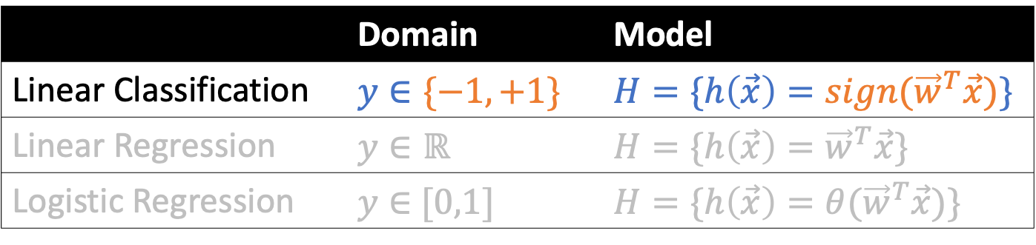
Linear Classification
 | Domain | Model
Linear Classification | $$y∈\{−1,+1\}$$ | $$H=\{h\left(\vec{x}\right)={sign(\vec{w}}^{T}\vec{x})\}$$
Linear Regression | $$y∈ℝ$$ | $$H=\{h\left(\vec{x}\right)={\vec{w}}^{T}\vec{x}\}$$
Logistic Regression | $y∈$ $[0,1]$ | $$H=\{h\left(\vec{x}\right)={θ(\vec{w}}^{T}\vec{x})\}$$

Slide 20

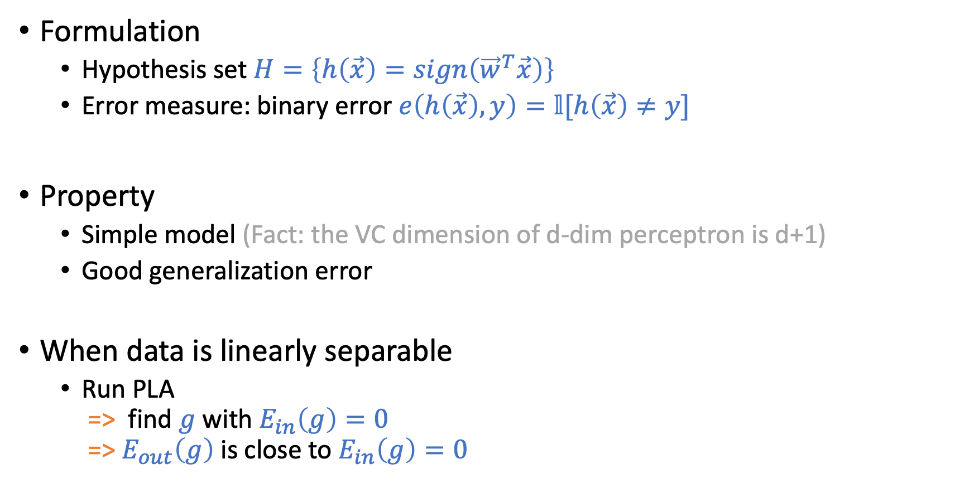
Linear Classification (Perceptron)
Formulation
Hypothesis set $H=\left\{h\left(\vec{x}\right)=sign\left({\vec{w}}^{T}\vec{x}\right)\right\}$
Error measure: binary error $e\left(h\left(\vec{x}\right),y\right)=𝕝[h\left(\vec{x}\right)≠y]$
Property
Simple model (Fact: the VC dimension of d-dim perceptron is d+1)
Good generalization error
When data is linearly separable
Run PLA => find $g$ with $E_{in}\left(g\right)=0$ => $E_{out}\left(g\right)$ is close to $E_{in}\left(g\right)=0$

Slide 21
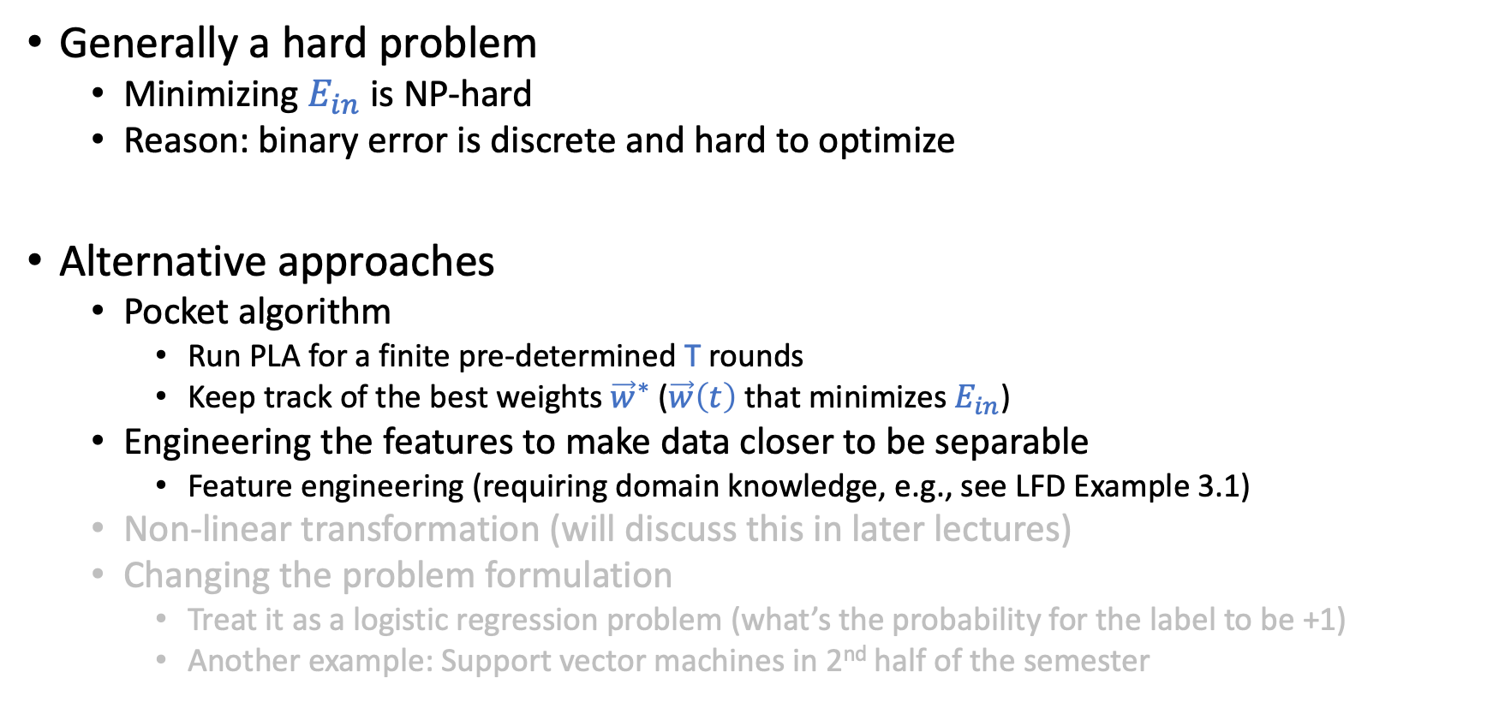
Non-Separable Data
Generally a hard problem
Minimizing $E_{in}$ is NP-hard
Reason: binary error is discrete and hard to optimize
Alternative approaches
Pocket algorithm
Run PLA for a finite pre-determined T rounds
Keep track of the best weights ${\vec{w}}^{∗}$ ($\vec{w}\left(t\right)$ that minimizes $E_{in}$)
Engineering the features to make data closer to be separable
Feature engineering (requiring domain knowledge, e.g., see LFD Example 3.1)
Non-linear transformation (will discuss this in later lectures)
Changing the problem formulation
Treat it as a logistic regression problem (what’s the probability for the label to be +1)
Another example: Support vector machines in 2nd half of the semester

Slide 22
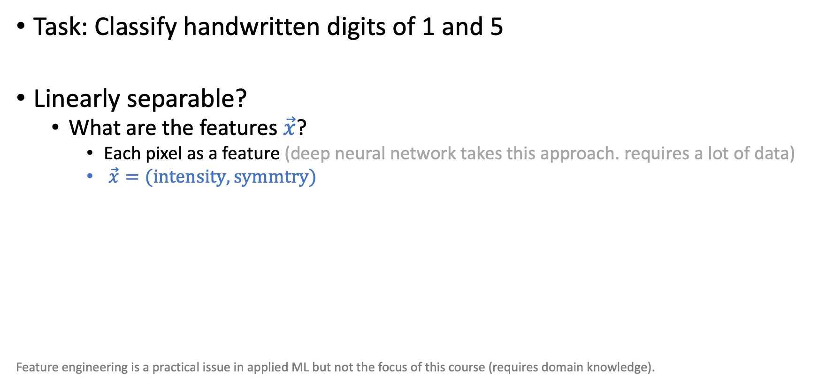
Example on Feature Engineering
Task: Classify handwritten digits of 1 and 5
Linearly separable?
What are the features $\vec{x}$?
Each pixel as a feature (deep neural network takes this approach. requires a lot of data)
$\vec{x}=(intensity, symmtry)$
Feature engineering is a practical issue in applied ML but not the focus of this course (requires domain knowledge).

Slide 23
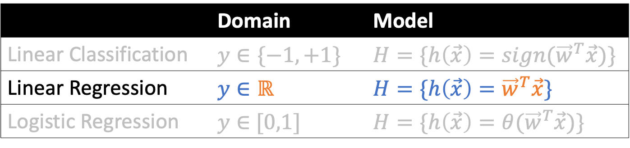
Linear Regression
 | Domain | Model
Linear Classification | $$y∈\{−1,+1\}$$ | $$H=\{h\left(\vec{x}\right)={sign(\vec{w}}^{T}\vec{x})\}$$
Linear Regression | $$y∈ℝ$$ | $$H=\{h\left(\vec{x}\right)={\vec{w}}^{T}\vec{x}\}$$
Logistic Regression | $y∈$ $[0,1]$ | $$H=\{h\left(\vec{x}\right)={θ(\vec{w}}^{T}\vec{x})\}$$

Slide 24
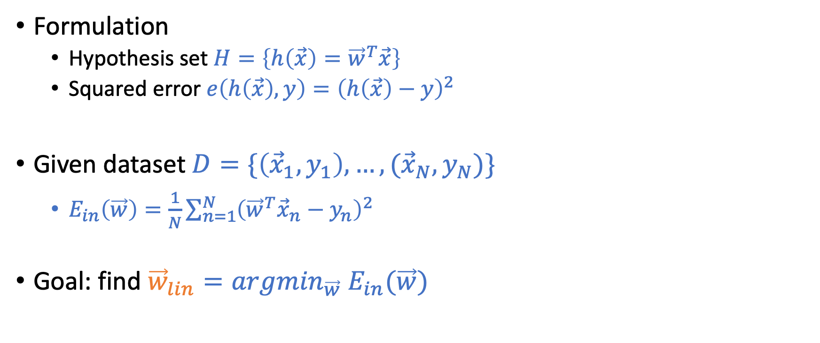
Linear Regression
Formulation
Hypothesis set $H=\left\{h\left(\vec{x}\right)={\vec{w}}^{T}\vec{x}\right\}$
Squared error $e\left(h\left(\vec{x}\right),y\right)={\left(h\left(\vec{x}\right)−y\right)}^{2}$
Given dataset $D=\{\left({\vec{x}}_{1},y_{1}\right),…,({\vec{x}}_{N},y_{N})\}$
$E_{in}\left(\vec{w}\right)=\frac{1}{N}\sum_{n=1}^{N}{{\left({\vec{w}}^{T}{\vec{x}}_{n}−y_{n}\right)}^{2}}$
Goal: find ${\vec{w}}_{lin}={argmin}_{\vec{w}} E_{in}(\vec{w})$

Slide 25
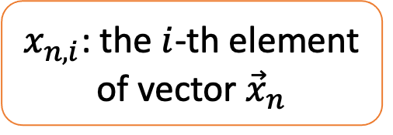
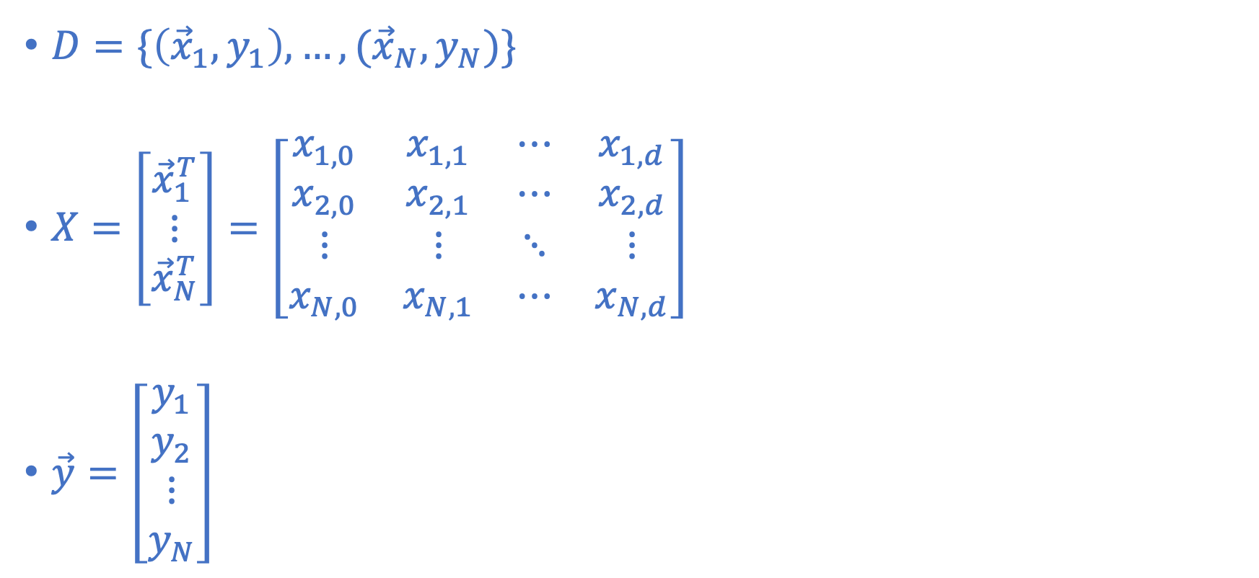
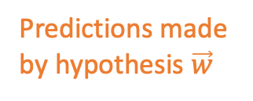
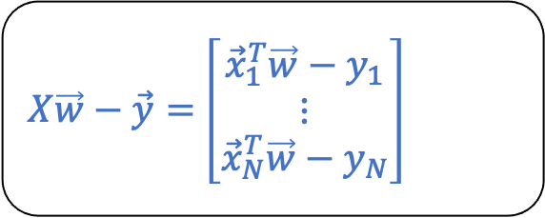
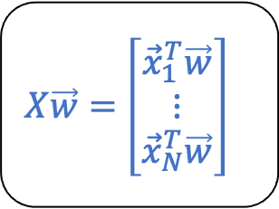
Matrix Representation
$D=\{\left({\vec{x}}_{1},y_{1}\right),…,({\vec{x}}_{N},y_{N})\}$
$X=\left[\begin{matrix}{\vec{x}}_{1}^{T} \\ ⋮ \\ {\vec{x}}_{N}^{T}\end{matrix}\right]=\left[\begin{matrix}x_{1,0} & x_{1,1} & ⋯ & x_{1,d} \\ x_{2,0} & x_{2,1} & ⋯ & x_{2,d} \\ ⋮ & ⋮ & ⋱ & ⋮ \\ x_{N,0} & x_{N,1} & ⋯ & x_{N,d}\end{matrix}\right]$
$\vec{y}=\left[\begin{matrix}y_{1} \\ y_{2} \\ ⋮ \\ y_{N}\end{matrix}\right]$
$x_{n,i}$: the $i$-th element of vector ${\vec{x}}_{n}$
Predictions made by hypothesis $\vec{w}$
$X\vec{w}=$ $\left[\begin{matrix}{\vec{x}}_{1}^{T}\vec{w} \\ ⋮ \\ {\vec{x}}_{N}^{T}\vec{w}\end{matrix}\right]$
$X\vec{w}−\vec{y}=$ $\left[\begin{matrix}{\vec{x}}_{1}^{T}\vec{w}−y_{1} \\ ⋮ \\ {\vec{x}}_{N}^{T}\vec{w}−y_{N}\end{matrix}\right]$

Slide 26

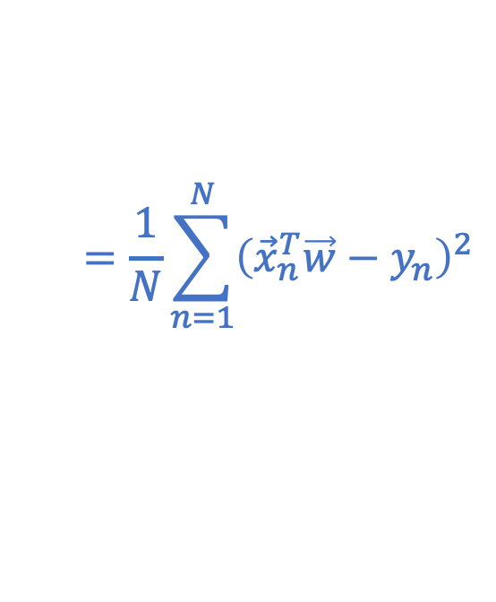
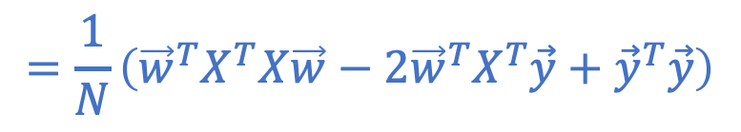
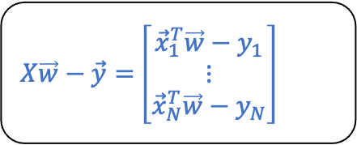
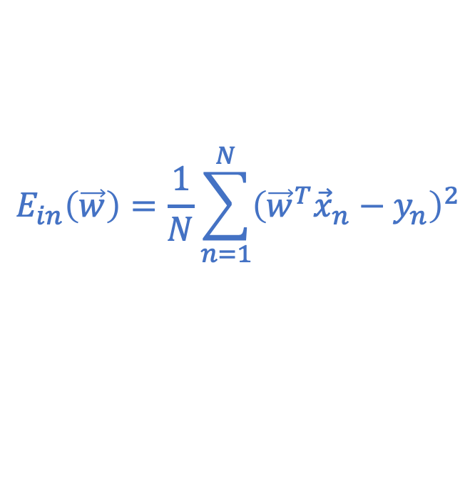
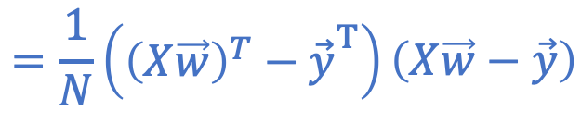
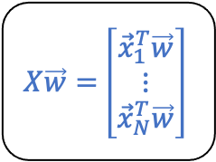
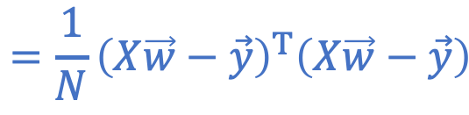
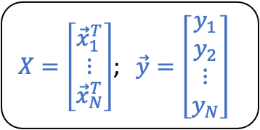
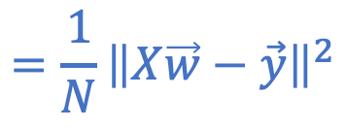
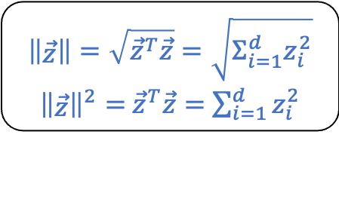
Rewriting the In-Sample Error In Matrix Form
$X=\left[\begin{matrix}{\vec{x}}_{1}^{T} \\ ⋮ \\ {\vec{x}}_{N}^{T}\end{matrix}\right]$; $\vec{y}=\left[\begin{matrix}y_{1} \\ y_{2} \\ ⋮ \\ y_{N}\end{matrix}\right]$
$X\vec{w}=$ $\left[\begin{matrix}{\vec{x}}_{1}^{T}\vec{w} \\ ⋮ \\ {\vec{x}}_{N}^{T}\vec{w}\end{matrix}\right]$
$X\vec{w}−\vec{y}=$ $\left[\begin{matrix}{\vec{x}}_{1}^{T}\vec{w}−y_{1} \\ ⋮ \\ {\vec{x}}_{N}^{T}\vec{w}−y_{N}\end{matrix}\right]$
$$E_{in}\left(\vec{w}\right)=\frac{1}{N}\sum_{n=1}^{N}{{\left({\vec{w}}^{T}{\vec{x}}_{n}−y_{n}\right)}^{2}}$$
$$=\frac{1}{N}\sum_{n=1}^{N}{{\left({\vec{x}}_{n}^{T}\vec{w}−y_{n}\right)}^{2}}$$
$$\left\|\begin{matrix}\vec{z}\end{matrix}\right\|=\sqrt{{\vec{z}}^{T}\vec{z}}=\sqrt{Σ_{i=1}^{d}z_{i}^{2}}$$
${\left\|\begin{matrix}\vec{z}\end{matrix}\right\|}^{2}=$ ${\vec{z}}^{T}\vec{z}=$ $\sum_{i=1}^{d}{z_{i}^{2}}$
$$=\frac{1}{N}{\left\|\begin{matrix}X\vec{w}−\vec{y}\end{matrix}\right\|}^{2}$$
$$=\frac{1}{N}\left({\begin{matrix}{\left(X\vec{w}\right)}^{T}−\vec{y}\end{matrix}}^{T}\right)\left(\begin{matrix}X\vec{w}−\vec{y}\end{matrix}\right)$$
$$E_{in}\left(\vec{w}\right)$$
$$=\frac{1}{N}{\left(\begin{matrix}X\vec{w}−\vec{y}\end{matrix}\right)}^{T}\left(\begin{matrix}X\vec{w}−\vec{y}\end{matrix}\right)$$
$$=\frac{1}{N}\left({\vec{w}}^{T}X^{T}X\vec{w}−2{\vec{w}}^{T}X^{T}\vec{y}+{\vec{y}}^{T}\vec{y}\right)$$

Slide 27
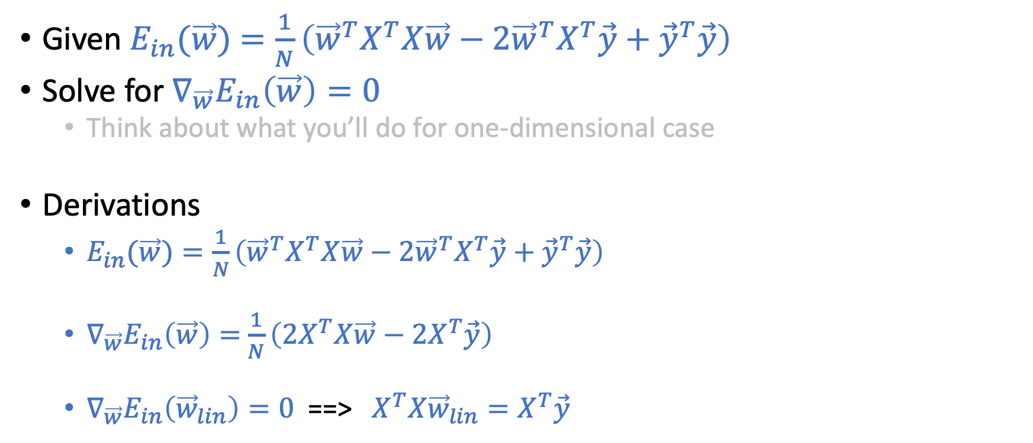
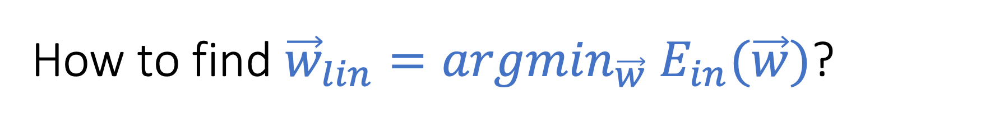
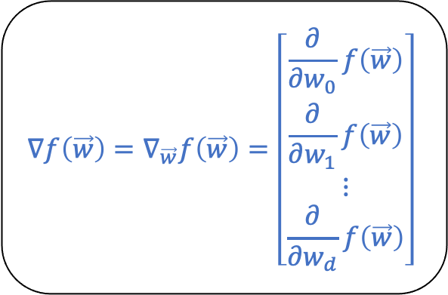
How to find ${\vec{w}}_{lin}={argmin}_{\vec{w}} E_{in}(\vec{w})$?
$$∇f\left(\vec{w}\right)=∇_{\vec{w}}f\left(\vec{w}\right)=\left[\begin{matrix}\frac{∂}{∂w_{0}}f\left(\vec{w}\right) \\ \begin{matrix}\frac{∂}{∂w_{1}}f\left(\vec{w}\right) \\ ⋮\end{matrix} \\ \frac{∂}{∂w_{d}}f\left(\vec{w}\right)\end{matrix}\right]$$
Given $E_{in}(\vec{w})$ $=\frac{1}{N}\left({\vec{w}}^{T}X^{T}X\vec{w}−2{\vec{w}}^{T}X^{T}\vec{y}+{\vec{y}}^{T}\vec{y}\right)$
Solve for $∇_{\vec{w}}E_{in}\left(\vec{w}\right)=0$
Think about what you’ll do for one-dimensional case
Derivations
$E_{in}(\vec{w})=\frac{1}{N}\left({\vec{w}}^{T}X^{T}X\vec{w}−2{\vec{w}}^{T}X^{T}\vec{y}+{\vec{y}}^{T}\vec{y}\right)$
$∇_{\vec{w}}E_{in}\left(\vec{w}\right)=$ $\frac{1}{N}\left(2X^{T}X\vec{w}−2X^{T}\vec{y}\right)$
$∇_{\vec{w}}E_{in}\left({\vec{w}}_{lin}\right)=0$ ==> $X^{T}X{\vec{w}}_{lin}=X^{T}\vec{y}$

Slide 28
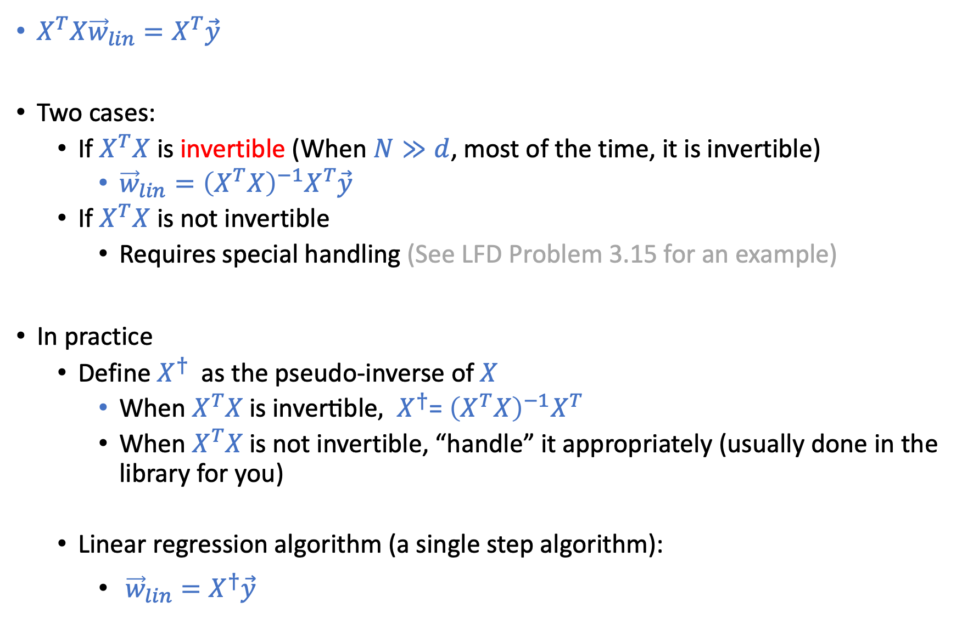
$X^{T}X{\vec{w}}_{lin}=X^{T}\vec{y}$
Two cases:
If $X^{T}X$ is invertible (When $N≫d$, most of the time, it is invertible)
${\vec{w}}_{lin}={\left(X^{T}X\right)}^{−1}X^{T}\vec{y}$
If $X^{T}X$ is not invertible
Requires special handling (See LFD Problem 3.15 for an example)
In practice
Define $X^{†}$ as the pseudo-inverse of $X$
${\text{Wh}\text{en} X^{T}X \text{is} \text{invertible}, X}^{†}$= ${\left(X^{T}X\right)}^{−1}X^{T}$
When $X^{T}X$is not invertible, “handle” it appropriately (usually done in the library for you)
Linear regression algorithm (a single step algorithm):
${\vec{w}}_{lin}=X^{†}\vec{y}$

Slide 29
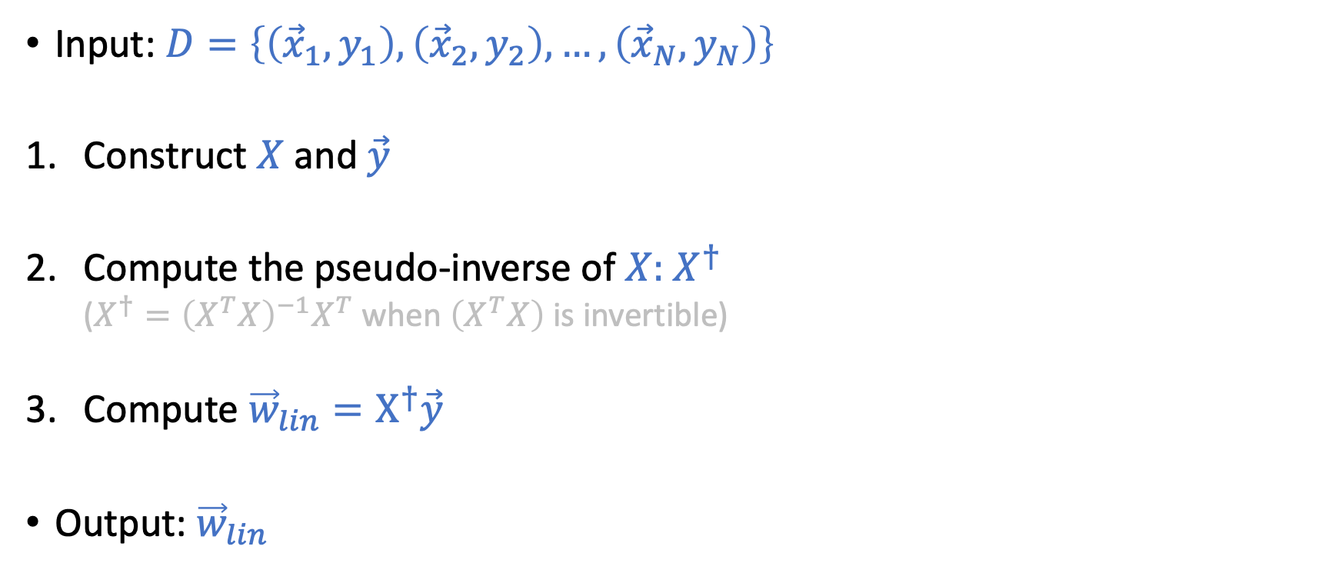
Linear Regression “Algorithm”
Input: $D=\left\{\left({\vec{x}}_{1},y_{1}\right),\left({\vec{x}}_{2},y_{2}\right),…,\left({\vec{x}}_{N},y_{N}\right)\right\}$
Construct $X$ and $\vec{y}$
Compute the pseudo-inverse of $X:$ $X^{†}$
($X^{†}={\left(X^{T}X\right)}^{−1}X^{T}$ when $\left(X^{T}X\right)$ is invertible)
Compute ${\vec{w}}_{lin}=X^{†}\vec{y}$
Output:${ \vec{w}}_{lin}$

Slide 30
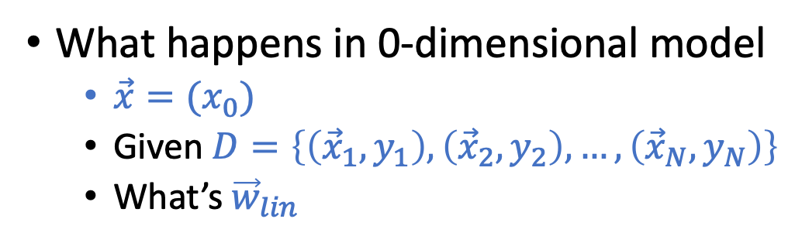
Short Discussion
What happens in 0-dimensional model
$\vec{x}=(x_{0})$
Given $D=\left\{\left({\vec{x}}_{1},y_{1}\right),\left({\vec{x}}_{2},y_{2}\right),…,\left({\vec{x}}_{N},y_{N}\right)\right\}$
What’s${ \vec{w}}_{lin}$

Slide 31
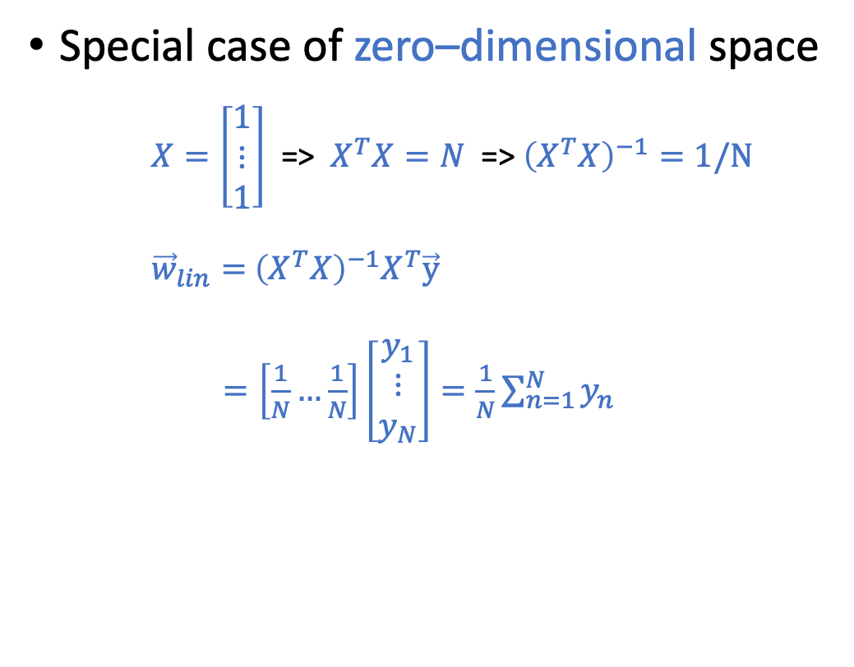
Short Discussion
Special case of zero–dimensional space
$X=\left[\begin{matrix}1 \\ ⋮ \\ 1\end{matrix}\right]$ => $X^{T}X=N$ => ${\left(X^{T}X\right)}^{−1}=1/N$
${\vec{w}}_{lin}=$ ${\left(X^{T}X\right)}^{−1}X^{T}\vec{y}$
$=\left[\frac{1}{N}…\frac{1}{N}\right]\left[\begin{matrix}y_{1} \\ ⋮ \\ y_{N}\end{matrix}\right]=\frac{1}{N}\sum_{n=1}^{N}{y_{n}}$
Squared error => mean

Slide 32
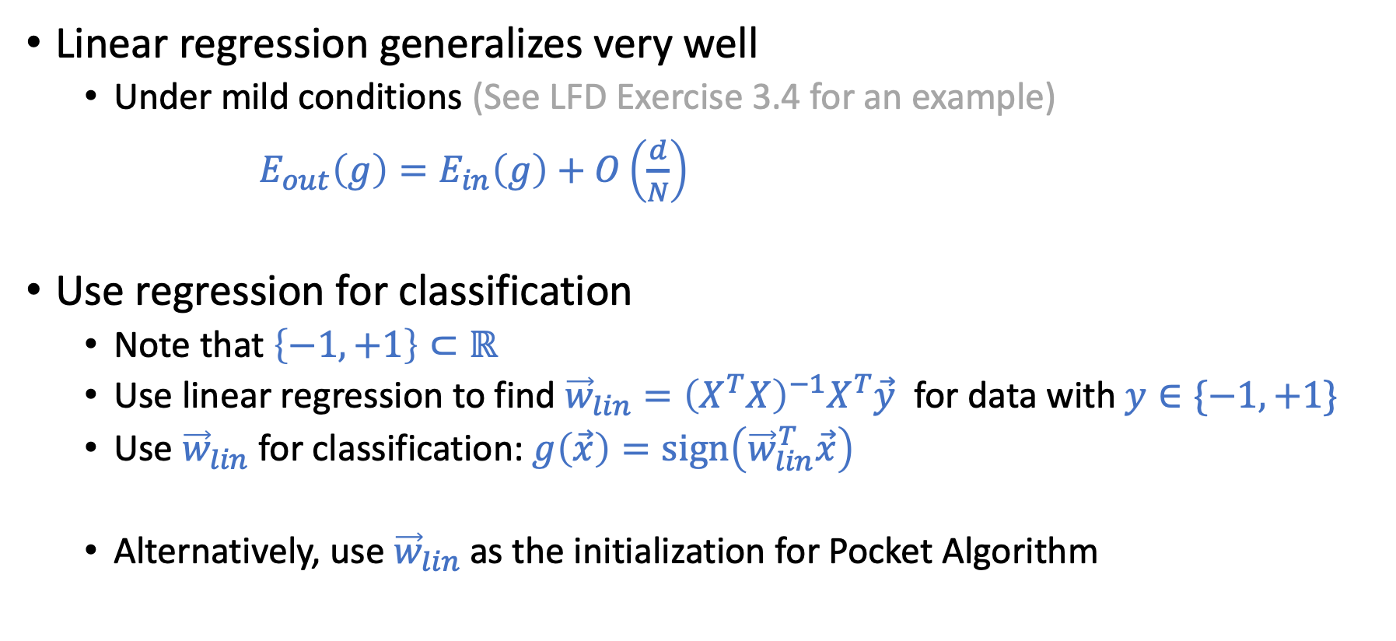
Discussion
Linear regression generalizes very well
Under mild conditions (See LFD Exercise 3.4 for an example)
$E_{out}\left(g\right)=E_{in}\left(g\right)+O\left(\frac{d}{N}\right)$
Use regression for classification
Note that $\left\{−1,+1\right\}⊂ℝ$
Use linear regression to find ${\vec{w}}_{lin}={\left(X^{T}X\right)}^{−1}X^{T}\vec{y}$ for data with $y∈\{−1,+1\}$
Use ${\vec{w}}_{lin}$ for classification:$g\left(\vec{x}\right)=sign\left({\vec{w}}_{lin}^{T}\vec{x}\right)$
Alternatively, use ${\vec{w}}_{lin}$ as the initialization for Pocket Algorithm

Slide 33
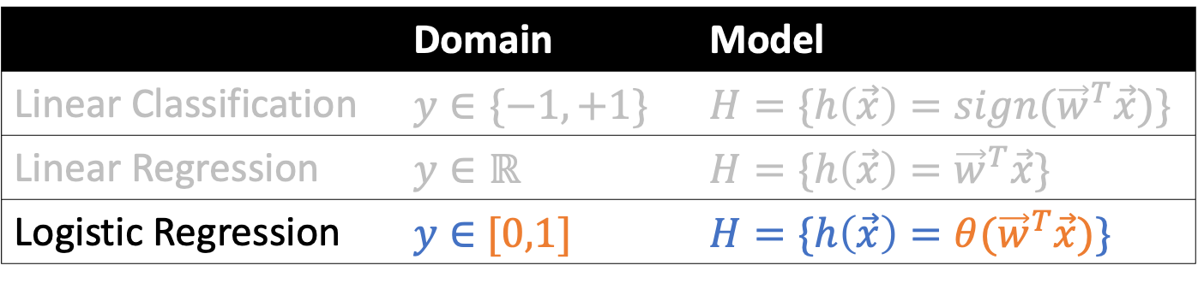
Logistic Regression
 | Domain | Model
Linear Classification | $$y∈\{−1,+1\}$$ | $$H=\{h\left(\vec{x}\right)={sign(\vec{w}}^{T}\vec{x})\}$$
Linear Regression | $$y∈ℝ$$ | $$H=\{h\left(\vec{x}\right)={\vec{w}}^{T}\vec{x}\}$$
Logistic Regression | $y∈$ $[0,1]$ | $$H=\{h\left(\vec{x}\right)={θ(\vec{w}}^{T}\vec{x})\}$$

Slide 34
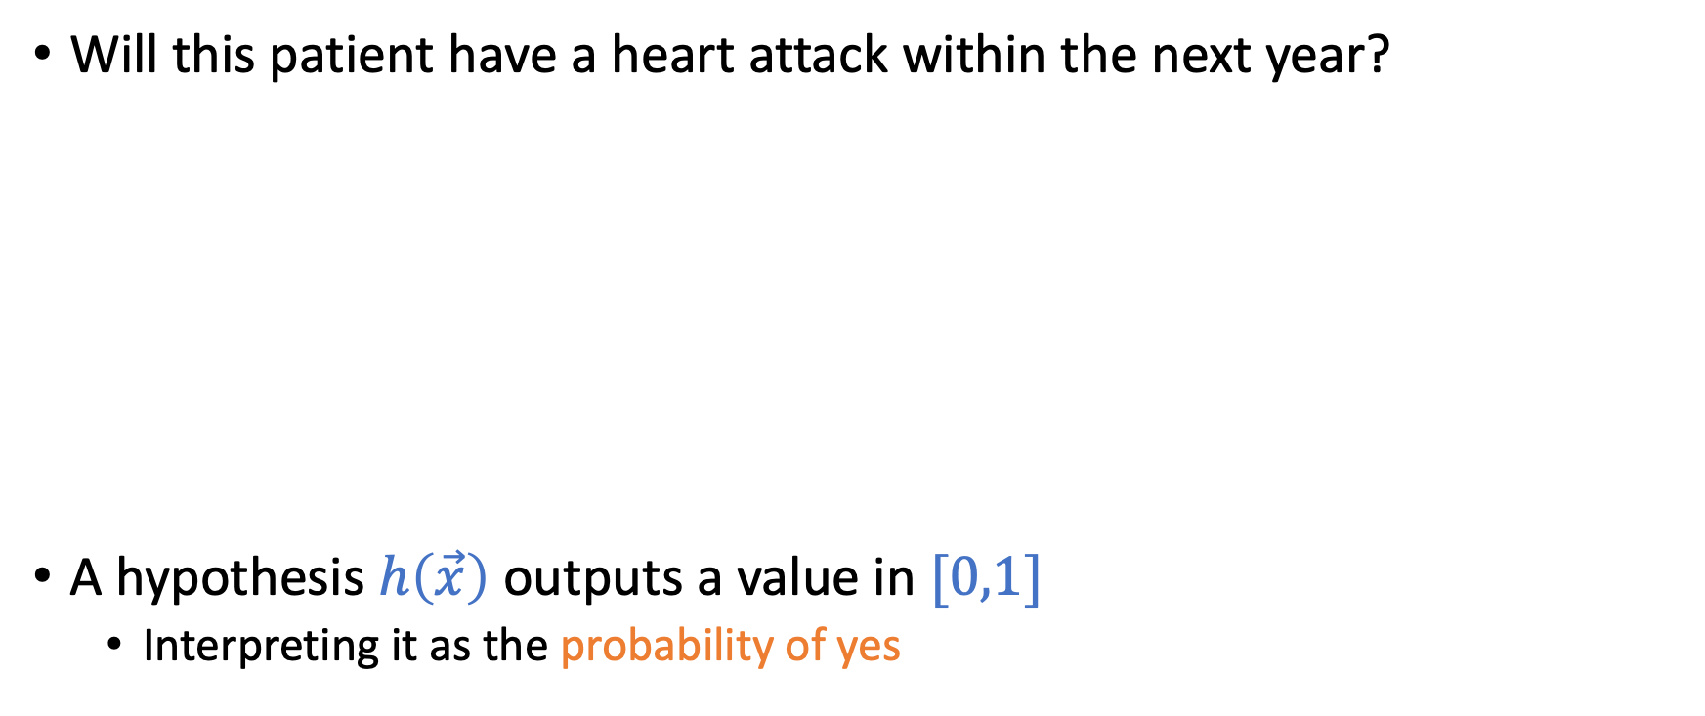
Logistic Regression: Predicting a Probability
Will this patient have a heart attack within the next year?
A hypothesis $h\left(\vec{x}\right)$ outputs a value in $[0,1]$
Interpreting it as the probability of yes
Classification: Yes/No
Logistic regression: Probability of Yes

Slide 35
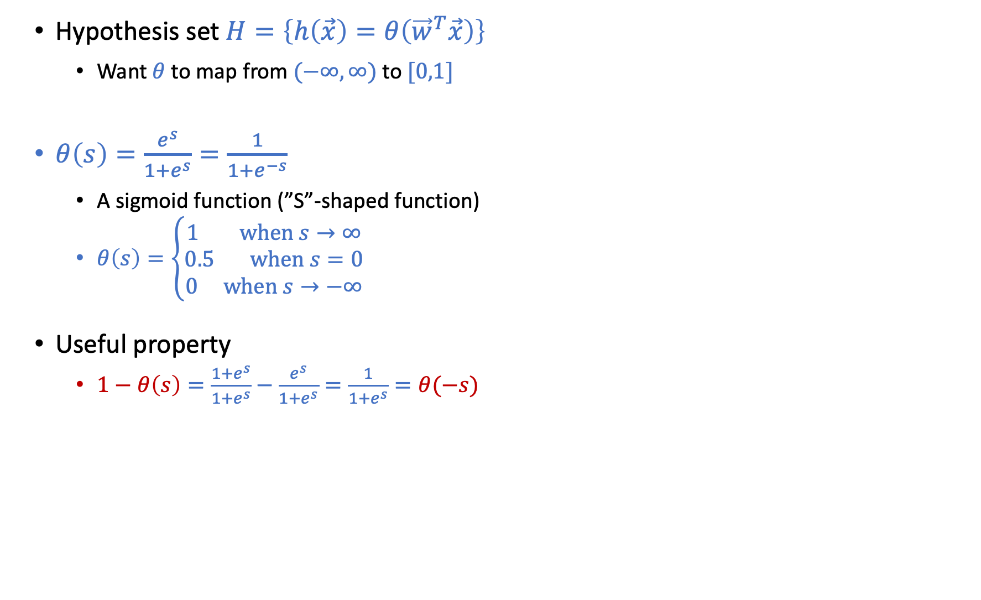
Logistic Regression: Predicting a Probability
Hypothesis set $H=\left\{h\left(\vec{x}\right)=θ\left({\vec{w}}^{T}\vec{x}\right)\right\}$
Want $θ$ to map from $(−∞,∞)$ to $[0,1]$
$θ\left(s\right)=\frac{e^{s}}{1+e^{s}}=\frac{1}{1+e^{−s}}$
A sigmoid function (”S”-shaped function)
$θ\left(s\right)=\left\{\begin{aligned}1 \text{when} s→∞ \\ 0.5 \text{when} s=0 \\ 0 \text{when} s→−∞\end{aligned}\right.$
Useful property
$1−θ\left(s\right)=\frac{1+e^{s}}{1+e^{s}}−\frac{e^{s}}{1+e^{s}}=\frac{1}{1+e^{s}}=θ(−s)$

Slide 36
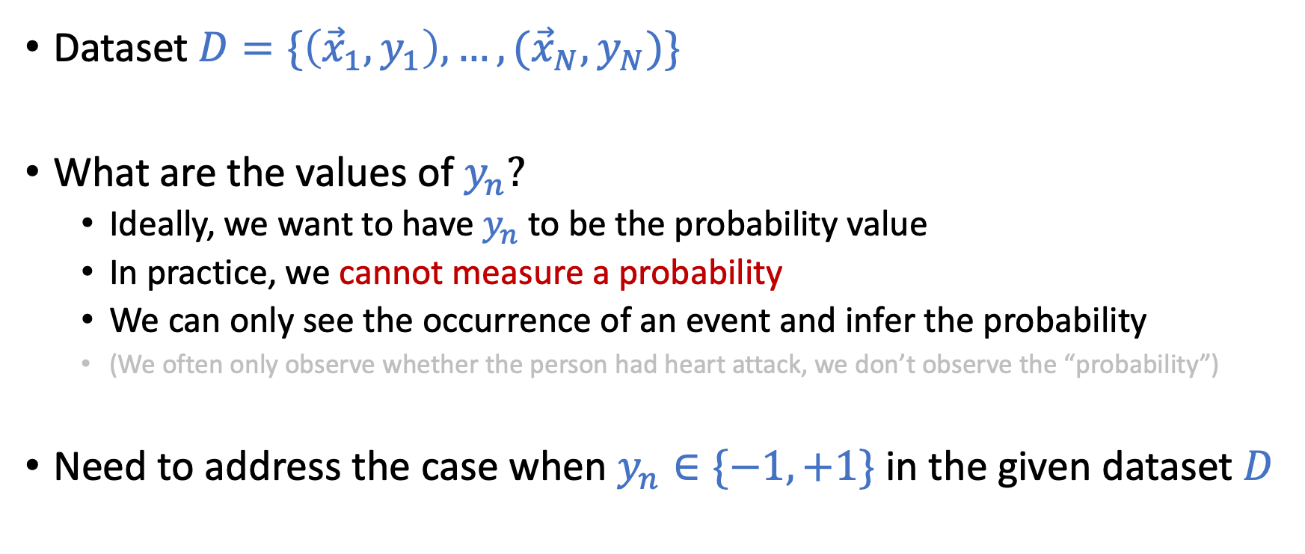
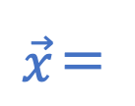
What Kind of Dataset do We Get?
Dataset $D=\{\left({\vec{x}}_{1},y_{1}\right),…,({\vec{x}}_{N},y_{N})\}$
What are the values of $y_{n}?$
Ideally, we want to have $y_{n}$ to be the probability value
In practice, we cannot measure a probability
We can only see the occurrence of an event and infer the probability
(We often only observe whether the person had heart attack, we don’t observe the “probability”)
Need to address the case when $y_{n}∈\{−1,+1\}$ in the given dataset $D$
$$\vec{x}＝$$

Slide 37
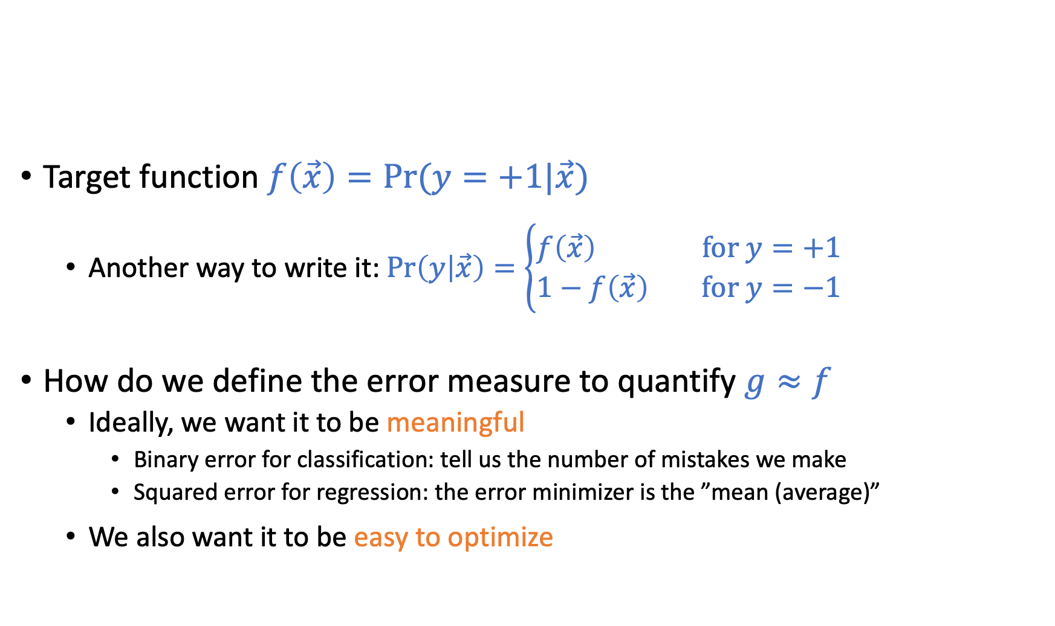

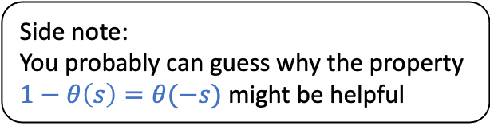
Error Measure: Quantifying $g≈f$
Side note:
You probably can guess why the property $1−θ\left(s\right)=θ(−s)$ might be helpful
Target function $f\left(\vec{x}\right)=Pr⁡(y=+1|\vec{x})$
Another way to write it: $\operatorname{Pr}\left(y | \vec{x}\right)=\left\{\begin{aligned}f\left(\vec{x}\right) \text{for} y=+1 \\ 1−f\left(\vec{x}\right) \text{for} y=−1\end{aligned}\right.$
How do we define the error measure to quantify $g≈f$
Ideally, we want it to be meaningful
Binary error for classification: tell us the number of mistakes we make
Squared error for regression: the error minimizer is the ”mean (average)”
We also want it to be easy to optimize

Slide 38

Cross Entropy Error
$$E_{in}\left(\vec{w}\right)=\frac{1}{N}\sum_{n=1}^{N}{\ln{(1+e^{−y_{n}{\vec{w}}^{T}{\vec{x}}_{n}})}}$$
It looks complicated, but
It has nice interpretations (min error => max likelihood)
It is easy to optimize (continuous, differentiable, convex)

Slide 39
Minimizing Cross Entropy Error Maximizing Likelihood

Slide 40

Maximum Likelihood Estimation
Likelihood $Pr⁡(D|h)$
The probability of seeing dataset $D$ if $D$ is generated according to $h$
$\operatorname{Pr}\left(D | h\right)=\operatorname{Pr}\left(\left({\vec{x}}_{1},y_{1}\right),…,\left({\vec{x}}_{N},y_{N}\right) | h\right)$
Maximum likelihood estimation (MLE)
$g=argmax_{h∈H}Pr⁡(D|h)$
Sidenote: Two different concepts in ML
Likelihood: $Pr⁡(D|h)$ [Focus of this course]
Posterior: $\operatorname{Pr}{(h|D)}$ [Focus of Bayesian machine learning: More in 515T]
Connection: $\operatorname{Pr}\left(h | D\right)=\frac{\operatorname{Pr}\left(h\right)Pr⁡(D|h)}{Pr⁡(D)}$
P$rior\operatorname{Pr}\left(h\right):$ the additional assumption Bayesian ML makes

Slide 41

Write Down the Likelihood
How are $D=\{\left({\vec{x}}_{1},y_{1}\right),…,({\vec{x}}_{N},y_{N})\}$ generated?
$\left({\vec{x}}_{1},…,{\vec{x}}_{N}\right)$ are i.i.d. drawn from a distribution
$(y_{1},…,y_{N})$ are labeled according to target function $f(\vec{x})$
Likelihood $Pr⁡(D|h)$
The probability of seeing dataset $D$ if $D$is generated according to $h$
$\operatorname{Pr}\left(D | h\right)=\operatorname{Pr}\left(\left({\vec{x}}_{1},y_{1}\right),…,\left({\vec{x}}_{N},y_{N}\right) | h\right)$
$=Pr\left({\vec{x}}_{1},…,{\vec{x}}_{N}\right) Pr\left(\left(y_{1},…,y_{N}\right)|\left({\vec{x}}_{1},…,{\vec{x}}_{N}\right), h\right)$
$=\prod_{n=1}^{N}{Pr⁡({\vec{x}}_{n})}$ $\prod_{n=1}^{N}{Pr⁡(y_{n}|{\vec{x}}_{n}, h)}$
(Assumption of independent data)

Slide 42


Maximum Likelihood
Choosing the hypothesis that maximizes the likelihood
$g=argmax_{h∈H}\operatorname{Pr}\left(D | h\right)$
$g=argmax_{h∈H}\prod_{n=1}^{N}{Pr⁡({\vec{x}}_{n})} \prod_{n=1}^{N}{Pr⁡(y_{n}|{\vec{x}}_{n}, h)}$
$g=argmax_{h∈H}\prod_{n=1}^{N}{Pr⁡(y_{n}|{\vec{x}}_{n}, h)}$
We interpret $h(\vec{x})$ as the probability of $y=+1$
$\operatorname{Pr}\left(y | \vec{x},h\right)=\left\{\begin{aligned}h\left(\vec{x}\right)=θ\left({\vec{w}}^{T}\vec{x}\right) \text{for} y=+1 \\ 1−h\left(\vec{x}\right)=1−θ\left({\vec{w}}^{T}\vec{x}\right) \text{for} y=−1\end{aligned}\right.$
Since $1−θ\left(s\right)=θ\left(−s\right)$
$\operatorname{Pr}\left(y | \vec{x},h\right)=$ $θ\left(y {\vec{w}}^{T}\vec{x}\right)$
$\prod_{n=1}^{N}{Pr⁡({\vec{x}}_{n})}$ doesn’t depend on $h$

Slide 43



Maximum Likelihood
Choosing the hypothesis that maximizes the likelihood
$g=argmax_{h∈H}\operatorname{Pr}\left(D | h\right)$
$g=argmax_{h∈H}\prod_{n=1}^{N}{Pr⁡(y_{n}|{\vec{x}}_{n}, h)}$
${\vec{w}}^{∗}=argmax_{\vec{w}}\prod_{n=1}^{N}{θ\left(y_{n}{\vec{w}}^{T}{\vec{x}}_{n}\right) }$
${\vec{w}}^{∗}=argmax_{\vec{w}}\ln\left(\prod_{n=1}^{N}{θ\left(y_{n}{\vec{w}}^{T}{\vec{x}}_{n}\right) }\right)$
${\vec{w}}^{∗}=argmax_{\vec{w}}\sum_{n=1}^{N}{ln⁡(θ\left(y_{n}{\vec{w}}^{T}{\vec{x}}_{n}\right))}{}$
${\vec{w}}^{∗}=argmin_{\vec{w}}−\sum_{n=1}^{N}{ln⁡(θ\left(y_{n}{\vec{w}}^{T}{\vec{x}}_{n}\right))}$
${\vec{w}}^{∗}=argmin_{\vec{w}}\sum_{n=1}^{N}{ln\frac{1}{θ\left(y_{n}{\vec{w}}^{T}{\vec{x}}_{n}\right)}}$
${\vec{w}}^{∗}=argmin_{\vec{w}}\sum_{n=1}^{N}{ln(1+e^{−y_{n}{\vec{w}}^{T}{\vec{x}}_{n}})}$
${\vec{w}}^{∗}=argmin_{\vec{w}}\frac{1}{N}\sum_{n=1}^{N}{ln(1+e^{−y_{n}{\vec{w}}^{T}{\vec{x}}_{n}})}$
$θ\left(s\right)=\frac{e^{s}}{1+e^{s}}=\frac{1}{1+e^{−s}}$
$$E_{in}\left(\vec{w}\right)=\frac{1}{N}\sum_{n=1}^{N}{\ln{(1+e^{−y_{n}{\vec{w}}^{T}{\vec{x}}_{n}})}}$$

Slide 44

Cross Entropy Error
$$E_{in}\left(\vec{w}\right)=\frac{1}{N}\sum_{n=1}^{N}{\ln{(1+e^{−y_{n}{\vec{w}}^{T}{\vec{x}}_{n}})}}$$
Minimizing $E_{in}\left(\vec{w}\right)$ is the same as maximizing likelihood
Next question: How to solve ${\vec{w}}^{∗}=argmin_{\vec{w}}E_{in}(\vec{w})$
Answer: Solve for $∇_{\vec{w}}E_{in}\left(\vec{w}\right)=0$
No single-step solution like we have in linear regression

Slide 45

Discussion
Using logistic regression for classification
Let ${\vec{w}}^{∗}$ or $g$ be the learned logistic regression model, can we make classification predictions using ${\vec{w}}^{∗}$?
Discuss potential ways to do this
Conditions on $g\left(\vec{x}\right)？$
Conditions on ${\vec{w}}^{∗^{T}}\vec{x}$?

Slide 46


Discussion
Using logistic regression for classification
Let ${\vec{w}}^{∗}$ or $g$ be the learned logistic regression model, can we make classification predictions using ${\vec{w}}^{∗}$?
Yes
Set a cutoff probability C$\%$ (e.g., 50%).
Classify +1 if $g\left(\vec{x}\right)=θ({{\vec{w}}^{∗}}^{T}\vec{x})>C\%$
Classify -1 if $g\left(\vec{x}\right)=θ({{\vec{w}}^{∗}}^{T}\vec{x})<C\%$
When $C$ is 50 (a common choice)
$θ({{\vec{w}}^{∗}}^{T}\vec{x})>50\%$ => ${{\vec{w}}^{∗}}^{T}\vec{x}>0$
Equivalent to using ${\vec{w}}^{∗}$ as the linear classification hypothesis, i.e., $g\left(\vec{x}\right)=sign({{\vec{w}}^{∗}}^{T}\vec{x})$
$$θ\left(s\right)=\left\{\begin{aligned}1 \text{when} s→∞ \\ 0.5 \text{when} s=0 \\ 0 \text{when} s→−∞\end{aligned}\right.$$

Slide 47
Logistic Regression

Slide 48

Logistic Regression: Predicting a Probability
Will this patient have a heart attack within the next year?
A hypothesis $h\left(\vec{x}\right)$ output a value in $[0,1]$
Interpreting it as the probability of yes
Classification: Yes/No
Logistic regression: Probability of Yes

Slide 49

Logistic Regression
Hypothesis set $H=\left\{h\left(\vec{x}\right)=θ\left({\vec{w}}^{T}\vec{x}\right)\right\}$
$θ\left(s\right)=\frac{e^{s}}{1+e^{s}}=\frac{1}{1+e^{−s}}$
A sigmoid function (”S”-shaped function)
$θ\left(s\right)=\left\{\begin{aligned}1 \text{when} s→∞ \\ 0.5 \text{when} s=0 \\ 0 \text{when} s→−∞\end{aligned}\right.$
Useful property
$1−θ\left(s\right)=\frac{1+e^{s}}{1+e^{s}}−\frac{e^{s}}{1+e^{s}}=\frac{1}{1+e^{s}}=θ(−s)$

Slide 50
What kind of Dataset do We Get?
Dataset $D=\{\left({\vec{x}}_{1},y_{1}\right),…,({\vec{x}}_{N},y_{N})\}$
What are the values of $y_{n}?$
Ideally, we want to have $y_{n}$ to be the probability value
In practice, we cannot measure a probability
We can only see the occurrence of an event and infer the probability
(We often only observe whether the person had heart attack, we don’t observe the “probability”)
Need to address the case when $y_{n}∈\{−1,+1\}$ in the given dataset $D$

Slide 51


How to Quantify $g≈f$
Target function $f\left(\vec{x}\right)=Pr⁡(y=+1|\vec{x})$
$\operatorname{Pr}\left(y | \vec{x}\right)=\left\{\begin{aligned}f\left(\vec{x}\right) \text{for} y=+1 \\ 1−f\left(\vec{x}\right) \text{for} y=−1\end{aligned}\right.$
How do define the error measure to quantify $g≈f$
Ideally, we want it to be meaningful
Binary error for classification: tell us the number of mistakes we make
Squared error for regression: the error minimizer is the ”mean (average)”
We also want it to be easy to optimize

Slide 52
Cross Entropy Error
$$E_{in}\left(\vec{w}\right)=\frac{1}{N}\sum_{n=1}^{N}{\ln{(1+e^{−y_{n}{\vec{w}}^{T}{\vec{x}}_{n}})}}$$
It looks complicated, but
It has nice interpretations (min error => max likelihood)
It is easy to optimize (continuous, differentiable, convex)

Slide 53

Likelihood
How are $D=\{\left({\vec{x}}_{1},y_{1}\right),…,({\vec{x}}_{N},y_{N})\}$ generated?
$\left({\vec{x}}_{1},…,{\vec{x}}_{N}\right)$ are i.i.d. drawn from a distribution
$(y_{1},…,y_{N})$ are labeled according to target function $f(\vec{x})$
Likelihood $Pr⁡(D|h)$
The probability of seeing dataset $D$ if we believe $y$ is generated according to $h$
$\operatorname{Pr}\left(D | h\right)=\operatorname{Pr}\left(\left({\vec{x}}_{1},y_{1}\right),…,\left({\vec{x}}_{N},y_{N}\right) | h\right)$
$=Pr\left({\vec{x}}_{1},…,{\vec{x}}_{N}\right) Pr\left(\left(y_{1},…,y_{N}\right)|\left({\vec{x}}_{1},…,{\vec{x}}_{N}\right), h\right)$
$=\prod_{n=1}^{N}{Pr⁡({\vec{x}}_{n})}$ $\prod_{n=1}^{N}{Pr⁡(y_{n}|{\vec{x}}_{n}, h)}$

Slide 54

Likelihood
How are $D=\{\left({\vec{x}}_{1},y_{1}\right),…,({\vec{x}}_{N},y_{N})\}$ generated?
$\left({\vec{x}}_{1},…,{\vec{x}}_{N}\right)$ are i.i.d. drawn from a distribution
$(y_{1},…,y_{N})$ are labeled according to target function $f(\vec{x})$
Likelihood $Pr⁡(D|h)$
The probability of seeing dataset $D$ if we believe $y$ is generated according to $h$
$\operatorname{Pr}\left(D | h\right)=\operatorname{Pr}\left(\left({\vec{x}}_{1},y_{1}\right),…,\left({\vec{x}}_{N},y_{N}\right) | h\right)$
$=Pr\left({\vec{x}}_{1},…,{\vec{x}}_{N}\right) Pr\left(\left(y_{1},…,y_{N}\right)|\left({\vec{x}}_{1},…,{\vec{x}}_{N}\right), h\right)$
$=\prod_{n=1}^{N}{Pr⁡({\vec{x}}_{n})}$ $\prod_{n=1}^{N}{Pr⁡(y_{n}|{\vec{x}}_{n}, h)}$
Assumption of independent data

Slide 55

Maximum Likelihood
Choosing the hypothesis that maximizes the likelihood
$g=argmax_{h∈H}\operatorname{Pr}\left(D | h\right)$
$g=argmax_{h∈H}\prod_{n=1}^{N}{Pr⁡({\vec{x}}_{n})} \prod_{n=1}^{N}{Pr⁡(y_{n}|{\vec{x}}_{n}, h)}$
$g=argmax_{h∈H}\prod_{n=1}^{N}{Pr⁡(y_{n}|{\vec{x}}_{n}, h)}$
We interpret $h(\vec{x})$ as the probability
$\operatorname{Pr}\left(y | \vec{x},h\right)=\left\{\begin{aligned}h\left(\vec{x}\right)=θ\left({\vec{w}}^{T}\vec{x}\right) \text{for} y=+1 \\ 1−h\left(\vec{x}\right)=1−θ\left({\vec{w}}^{T}\vec{x}\right) \text{for} y=−1\end{aligned}\right.$
Since $1−θ\left(s\right)=θ(−s)$, we have $\operatorname{Pr}\left(y | \vec{x},h\right)=$ $θ\left(y {\vec{w}}^{T}\vec{x}\right)$
$\prod_{n=1}^{N}{Pr⁡({\vec{x}}_{n})}$ doesn’t depend on $h$

Slide 56


Maximum Likelihood
Choosing the hypothesis that maximizes the likelihood
$g=argmax_{h∈H}\operatorname{Pr}\left(D | h\right)$
$g=argmax_{h∈H}\prod_{n=1}^{N}{Pr⁡(y_{n}|{\vec{x}}_{n}, h)}$
${\vec{w}}^{∗}=argmax_{\vec{w}}\prod_{n=1}^{N}{θ\left(y_{n}{\vec{w}}^{T}{\vec{x}}_{n}\right) }$
${\vec{w}}^{∗}=argmax_{\vec{w}}\ln\left(\prod_{n=1}^{N}{θ\left(y_{n}{\vec{w}}^{T}{\vec{x}}_{n}\right) }\right)$
${\vec{w}}^{∗}=argmax_{\vec{w}}\sum_{n=1}^{N}{ln⁡(θ\left(y_{n}{\vec{w}}^{T}{\vec{x}}_{n}\right))}{}$
${\vec{w}}^{∗}=argmin_{\vec{w}}−\sum_{n=1}^{N}{ln⁡(θ\left(y_{n}{\vec{w}}^{T}{\vec{x}}_{n}\right))}$
${\vec{w}}^{∗}=argmin_{\vec{w}}\sum_{n=1}^{N}{ln\frac{1}{θ\left(y_{n}{\vec{w}}^{T}{\vec{x}}_{n}\right)}}$
${\vec{w}}^{∗}=argmin_{\vec{w}}\sum_{n=1}^{N}{ln(1+e^{−y_{n}{\vec{w}}^{T}{\vec{x}}_{n}})}$
$θ\left(s\right)=\frac{e^{s}}{1+e^{s}}=\frac{1}{1+e^{−s}}$
$$E_{in}\left(\vec{w}\right)=\frac{1}{N}\sum_{n=1}^{N}{\ln{(1+e^{−y_{n}{\vec{w}}^{T}{\vec{x}}_{n}})}}$$

Slide 57
Cross Entropy Error
$$E_{in}\left(\vec{w}\right)=\frac{1}{N}\sum_{n=1}^{N}{\ln{(1+e^{−y_{n}{\vec{w}}^{T}{\vec{x}}_{n}})}}$$
Minimizing $E_{in}\left(\vec{w}\right)$ is the same as maximizing likelihood
Next question: How to solve ${\vec{w}}^{∗}=argmin_{\vec{w}}E_{in}(\vec{w})$
Answer: Solve for $∇_{\vec{w}}E_{in}\left(\vec{w}\right)=0$
No single-step solution like we have in linear regression

